Slide 1

Alzheimer ’s disease Detection Using Machine Learning Algorithms

Slide 2
Abstract
Alzheimer’s disease (AD) is a neurodegenerative disease affects primarily the elderly population. It is a progressive disease and the fact that there is no treatment to stop or reverse the progression of the disease. It is the one amongst neurodegenerative disorders. Though the symptoms are benign initially, they become more severe over time. It is distinctly possible to reach 135 million by 2050.This disease is challenging one because there is no treatment for the disease. Diagnosis of the disease is done but that too at the later stage only. Thus if the disease is predicted earlier, the progression or the symptoms of the disease can be slowed down. This paper uses machine learning algorithms to predict Alzheimer disease using psychological parameters

Slide 3
Introduction
Alzheimer disease is caused by both genetic and environmental factors, those affects the brain of a person over time. The genetic changes guarantee a person will develop this disease. This disease breaks the brain tissue over time. It occurs to people over age 65. However people live with this disease for about 9 years and about 1 among 8 people of age 65 and over have this disease. The proposed algorithm uses Boltzmann machine for classification of multimodal data using learning using privileged information (LUPI). Although SVM classifiers can efficiently classify single modal data, multimodal data cannot be efficiently handled by SVM. A combination of RBM and SVM classifiers using Learning using Privileged Information (LUPI) was also proposed in this paper for the efficient classification of brain diseases

Slide 4
Literature Survey
1.2021 (Perez-Valero, E.; Lopez-Gordo,) A Review of Automated Techniques for Assisting the Early Detection of Alzheimer’s Disease with a Focus on EEG: The state-of-the-art approaches that apply signal processing (SP) and machine learning (ML) to automate the detection of Alzheimer’s disease (AD) and its prodromal stages. The economic and social implications of the disease, traditional diagnosis techniques, and the fundaments of automated AD detection. Then, we present electroencephalography (EEG) as an appropriate alternative for the early detection of AD, owing to its reduced cost, portability, and non-invasiveness.[7]

Slide 5
Literature Survey
2. 2020 (Zhao, Y.; Zhao, Y.; Durongbhan, P.;) Imaging of Nonlinear and Dynamic Functional Brain Connectivity Based on EEG Recordings With the Application on the Diagnosis of Alzheimer’s Disease: This accurately diagnoses the condition based on information derived from resting state electroencephalogram (EEG) recordings, aiming to detect brain network disruption. This article proposes a novel brain functional connectivity imaging method, particularly targeting the contribution of nonlinear dynamics of functional connectivity, on distinguishing participants with AD from healthy controls (HC).[15]

Slide 6
Literature Survey
3. 2019 (Musaeus, C.S.; Salem, L.C.; Sabers, A.; Kjaer, T.W.;) Associations between electroencephalography power and Alzheimer’s disease in persons with Down syndrome: This included 21 persons with DS-AD and 16 with DS without cognitive deterioration assessed by the informant-based Dementia Screening Questionnaire in Intellectual Disability. EEG was recorded for all participants. Absolute power for each electrode and global power were calculated for all frequency bands for both eyes open and eyes closed.[17]

Slide 7
Literature Survey
4.2018 (Bairagi, V.) EEG signal analysis for early diagnosis of Alzheimer disease using spectral and wavelet-based features: Electroencephalogram (EEG) signal analysis can be well suited for automated diagnosis of Alzheimer’s disease. This paper focuses on spectral and wavelet features for diagnosis of Alzheimer using EEG signals with effective increase in diagnostic accuracy for improvement in diagnosis in early stage. The use of spectral and wavelet-based features is proposed in this paper, with effective increase in classification accuracy by use of supervised classifiers giving 94% diagnostic accuracy for early Alzheimer’s diagnosis.[45]

Slide 8
Literature Survey
5.2021 (Susana, C.F.; Mónica, L.; Fernando, D.) Event-related brain potential indexes provide evidence for some decline in healthy people with subjective memory complaints during target evaluation and response inhibition processing: In this study, healthy adult participants with high and low SMCs (HSMCs and LSMCs) performed a Go/NoGo task during electroencephalogram (EEG) recording. Relative to LSMC participants, HSMC participants performed the task slower (longer reaction times) and showed changes in the event-related potential (ERP) components associated with response preparation (lower readiness potential -RP- amplitude in the Go condition), and also related to response inhibition processes (lower N2-P3 amplitude in the NoGo condition).[14]

Slide 9
Literature Survey
6.2020 (Fu, R.; Tian, Y.; Shi, P.; Bao, T.) Automatic Detection of Epileptic Seizures in EEG Using Sparse CSP and Fisher Linear Discrimination Analysis Algorithm: This combined sparse idea and greedy search algorithm to improve the feature extraction of common space pattern. The feature extraction can effectively overcome the repeating selection problem of feature pattern in the eigenvector space by the traditional method. Then we used the Fisher linear discriminant analysis to realize the classification. The results show that the proposed method can get high classification accuracy using fewer data. For 10 subjects, the averaged accuracy of epilepsy detection is more than 92%.[35]

Slide 10
Existing Methodology
Method of deep learning along with the brain network and clinically significant information like age, ApoE gene and gender of the subjects for earlier examination of Alzheimer’s.
Brain network was arranged, calculating functional connections in the brain region by employing the resting-state functional magnetic resonance imaging (R-fMRI) data.
To produce a detailed discovery of the early AD, a deep network like auto encoder is used where functional connections of the networks are constructed and are susceptible to AD and MCI. The dataset is taken from the ADNI database.
The classification model consists of the early diagnosis, initially preprocessing of raw R-fMRI is done. Then, the time series data (90 ×130matrix) is obtained and that indicates blood oxygen levels in each and every region of the brain and changes over a long period.
The targeted auto encoder model is used which is a three-layered model which gives intellectual growth of the nervous system then extracts brain networks attributes completely.

Slide 11
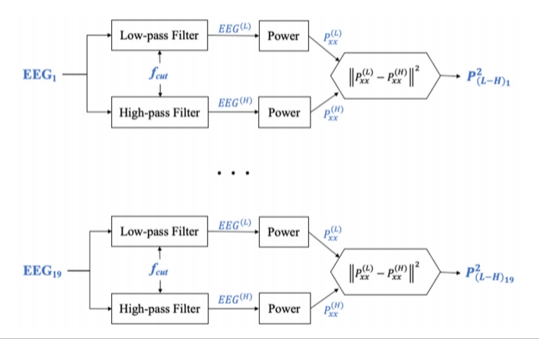
Drawbacks Of Existing System
The ability to collect, store, manage and process data has been difficult in existing methods. The stage of artificial intelligence is also defined as a discipline about knowledge, namely the technology about how to acquire and express the knowledge and convert it into practical applications

Slide 12
Objectives
Support Clinical Decision Making
Accuracy Improvement
Monitoring Disease Progression
Risk Prediction
Feature Selection and Biomarker Identification
Non-Invasive Diagnosis
Personalized Medicine

Slide 13
Proposed system
Proposed a method called multistage classifier by using machine learning algorithms like Support Vector Machine, Naïve Bayes and K-nearest neighbor to classify between different subjects.
PSO (particle swarm optimization) which is a technique that best selects the features was enforced to obtain best features. Naturally image retrieving process requires two stages: the first stage involves generating features so that it reproduces the query image and then later step correlate those features with those already gathered in the database
The PSO algorithm is used to select the finest biomarkers that show AD or MCI. The data is Alzheimer’s disease Neuroimaging Initiative (ADNI) database. The MRI scans are preprocessed first after taking from the database. The feature selection includes volumetric and thickness measurements. Then the optimum feature lists were obtained from PSO algorithm.

Slide 14
Advantages Of Proposed System
SVM is a directed study model that classifies by separating the objects using a hyper plane. It can be used for both classification and regression. The hyper planes are drawn with the help of the margins. The main goal is to maximize the distance between the hyper plane and the margin. The margins are drawn with the help of support vectors that are belonging to the objects. The main advantage of SVM is that it can distinguish linear and non-linear objects.
The proposed machine learning system aims to provide an efficient, cost-effective, and accessable tool for early detection and diagnosis of Alzheimer’s disease, facilitating timely intervention and personalized treatment.

Slide 15
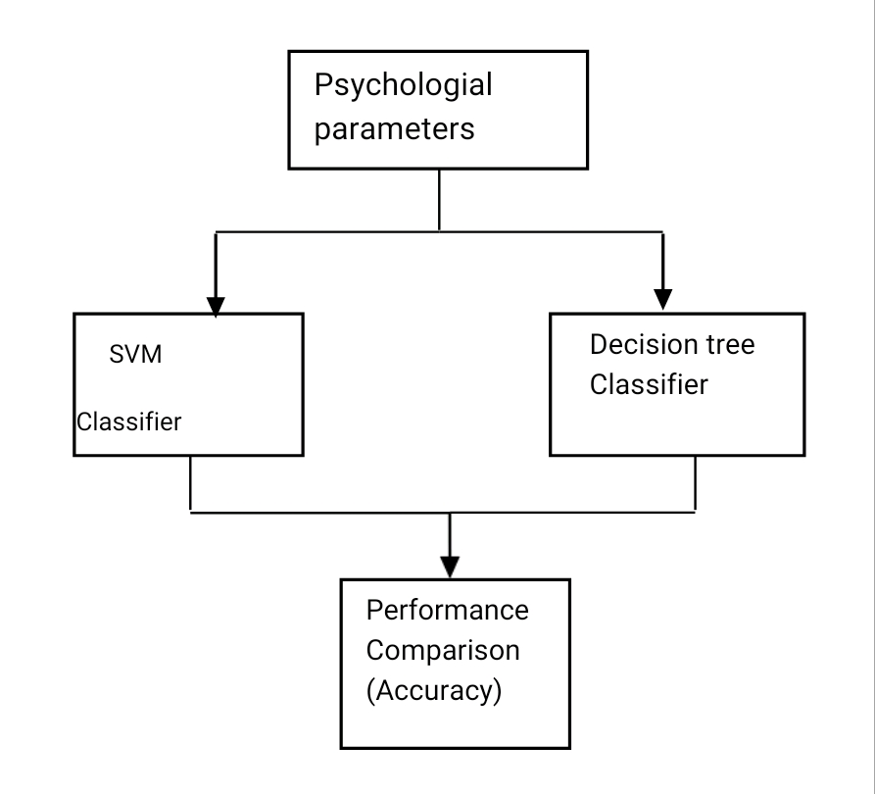
Block Diagram

Slide 16


